Slide 1
AIF182204 - Pemrograman Berbasis Web HTML (1)
by Raymond Chandra Putra
03-03-2022

Slide 2
What is HTML?
HTML (Hypertext Markup Language)
Describes the content and structure of a web page; not a programming language.
Made up of building blocks called elements.
HTML pages are text documents.

Slide 3
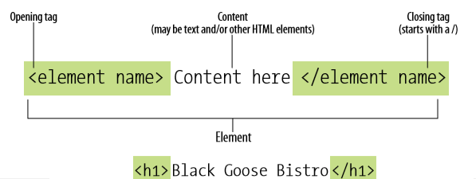
HTML Elements
Identified by tags
A tag consist of the element name within angle brackets ( < > )
Browser knows any text within brackets is hidden and not displayed in the browser window
Notes:
Element name appears in the opening tag/start tag, and again in the closing (or end) tag preceeded by a slash (/).
Capitalization is not important: <img>, <Img>, <IMG> are all the same.

Slide 4
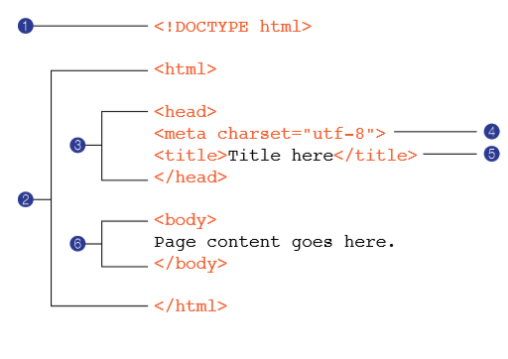
HTML Structure
Notes:
DOCTYPE declaration: identifies this document as (for example) HTML5 document. The <!DOCTYPE> declaration is not an HTML tag; it is an instruction to the web browser about what version of HTML the page is written in.
The entire document is contained within an html element.
Within html element, the document is divided into head and body. Head element contains descriptive information about the document itself, such as its title, the style sheet(s) it uses, scripts and other types of meta information.
The meta elements within the head element provide information about the document itself. A meta element can be used to provide all sort information. Meta elements are typically used to specify page description, keywords, author of the document, last modified, and other metadata.
The title element contains the title of a web page.
The body element contains everything that we want to show up in the browser window.

Slide 5
Nesting Elements
Elements inside elements
Example:
<p>My cat is <strong>very</strong> grumpy.</p>
<p>My cat is <strong>very grumpy.</p></strong>

Slide 6
HTML Elements
Block level element
appears on a new line
Ex: <h1>, <p>, <ul>, and <li>
Inline element
continue on the same line as its neighboring elements
Ex: <a>, <b>, <em>, and <img>
Code:
<em>first</em><em>second</em><em>third</em>
<p>fourth</p><p>fifth</p><p>sixth</p>
Reference:
https://developer.mozilla.org/en-US/docs/Web/HTML/Reference

Slide 7
HTML Attribute
Basic
<p class=”editor-note”>My cat is very grumpy</p>
Boolean attribute
<input type="text" disabled="disabled">
<input type="text" disabled>
Notes:
<a href=https://www.mozilla.org/ title=The Mozilla homepage> eror
Our advice is to always include the attribute quotes
single or double quote

Slide 8
HTML Text
Used to describe the content’s meaning
Ensures the content is available and accessible in the widest range of browsing environment
Allows non-human readers (such as search engine) to correctly parse the web content and make decision about the relative importance of elements on the page

Slide 9
HTML Text: Paragraph
Example:
<p>Serif typefaces have small slabs at the ends of letter strokes.
In general, serif fonts can make
large amounts of text easier to read.</p>

Slide 10

HTML Text: Line Break
Example:
<p>Serif typefaces have small slabs at the ends of letter strokes.<br>In general, <br>serif fonts can make large<br>amounts of text easier to read.</p>

Slide 11
HTML Text: Preformated Text
In some types of information (code examples or poetry) the whitespace is important for conveying meaning.
The preformatted text (pre) element is a unique element in that it is displayed exactly as it is typed, including all the carriage returns and multiple character spaces.

Slide 12
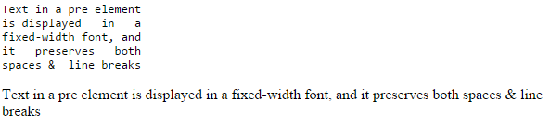
HTML Text: Preformated Text
Example:
<pre>
Text in a pre element
is displayed in a
fixed-width font, and
it preserves both
spaces & line breaks
</pre>
<p>
Text in a pre element
is displayed in a
fixed-width font, and
it preserves both
spaces & line breaks
</p>

Slide 13
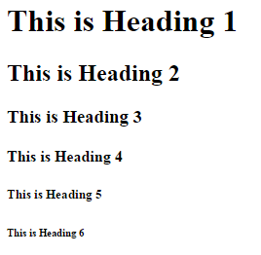
HTML Text: Headings
Example:
<h1>This is Heading 1</h1>
<h2>This is Heading 2</h2>
<h3>This is Heading 3</h3>
<h4>This is Heading 4</h4>
<h5>This is Heading 5</h5>
<h6>This is Heading 6</h6>

Slide 14
HTML Text: Formatting
<b> | bold text
<strong> | bold text, with added semantic importance
<i> | italic text
<em> | italic text, with added semantic importance
<u> | underlined text
<s> | strikethrough text (now obsolete)
<small> | smaller text
<mark> | highlighted text
<del> | deleted text (displayed with a strikethrough)
<ins> | inserted text (displayed with an underline)
<sub> | subscript text
<sup> | superscript text

Slide 15
HTML List
HTML provides element for marking up three types of lists:
Unordered lists: collections of items that appear in no particular order.
Ordered lists: lists in which the sequence of the items is important.
Description lists: lists that consist of name and value pairs, including but not limited to terms of definitions.

Slide 16
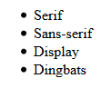
HTML List: Unordered List
Example:
<ul>
<li>Serif</li>
<li>Sans-serif</li>
<li>Display</li>
<li>Dingbats</li>
</ul>

Slide 17
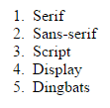
HTML List: Ordered List
Example:
<ol>
<li>Serif</li>
<li>Sans-serif</li>
<li>Script</li>
<li>Display</li>
<li>Dingbats</li>
</ol>

Slide 18

HTML List: Descriptive List
Example:
<dl>
<dt>Coffee</dt>
<dd>Black hot drink</dd>
<dt>Milk</dt>
<dd>White cold drink</dd>
</dl>

Slide 19
HTML Links
Types of links:
Links from one website to another
Links from one page to another on the same website
Links from one part of a web page to another part of the same page
Links that start up your email program and address a new email to someone

Slide 20
HTML Links
Links are created using the <a> element.
Users can click on anything between the opening <a> tag and the closing </a> tag.
You specify which page you want to link to using the href attribute.
target location
clickable text
<a href="http://www.imdb.com">IMDB</a>
opening tag
closing tag

Slide 21
HTML Links
to link to other pages within the same site, we don’t need to specify full URL, instead we can use a relative URL

Slide 22
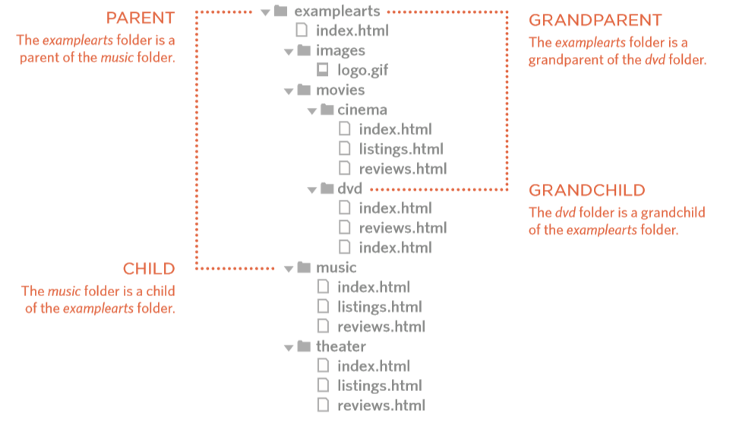
HTML Links
Example:

Slide 23
HTML Links
same folder: type only the file name Ex: <a href="reviews.html">Reviews</a>
child folder: type the folder name, slash, file name Ex: <a href="music/listings.html">Reviews</a>
parent folder: type ../ to move up one level Ex: <a href="../index.html">Reviews</a>

Slide 24
HTML Links: E-mail Link
Starts the value of the href attribute with mailto: and follows by the email address the email to be sent to
Example:
<a href="mailto:jon@example.org">Email Jon</a>

Slide 25
HTML Links: to specific part of a page
Need to identify the points in the page that the link will go to using the id attribute (can be used in any HTML element)
The value of the id attribute should start with a letter or an underscore
id attributes on a single page must be unique
To link to an element that uses an id attribute, starts the href value with the # symbol, followed by id name
<h1 id="top">Film-Making Terms</h1>
…
…
<a href="#top">Top</a>
<a href="http://www.myfilms.com/terms.html#top">Full URL</a>

Slide 26
HTML Links: target
To open link in a new window: add attribute target="_blank"
Other options:
_self opens in the same frame as it was clicked
_parent opens in the parent frame
_top opens in the full body of the window
framename opens in the named frame

Slide 27
HTML Images
<img> element is used to add an image into the
This is an empty element (no closing tag).
It must carry the src attributes This tells the browser where it can find the image file. This will usually be a relative URL pointing to an image on your own site.
Recommended attributes:
alt
This provides a text description of the image which describes the image if you cannot see it.
title
This provides additional information about the image. Most browsers will display the content of this attribute in a tooltip when the user hovers over the image.

Slide 28
HTML Images
Other attributes:
height This specifies the height of the image in pixels
width This specifies the width of the image in pixels
Note:
Some attributes are now replaced by using CSS. We will learn it later

Slide 29
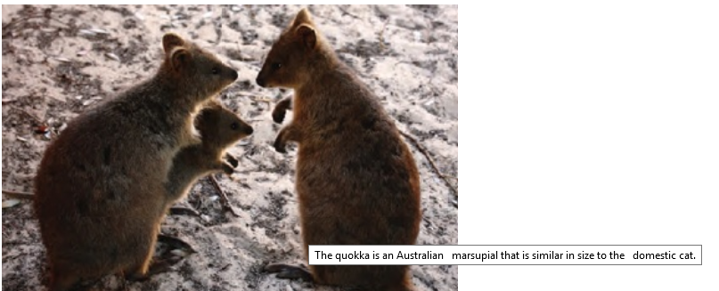
HTML Images
Example:
<img src="quokka.jpg" alt="A family of quokka" title="The quokka is an Australian marsupial that is similar in size to the domestic cat." />

Slide 30
HTML Tables
The <table> element is used to create a table. The contents of the table are written out row by row. The end of the table is closed by </table> tag.
The start of each row is indicate by the opening <tr> tag, and is closed by a </tr> tag.
Inside each row, there is one or more cell(s) indicated by <td> and </td> tags.

Slide 31

HTML Tables
Example:
<table>
<tr>
<td>Jill</td>
<td>Smith</td>
<td>50</td>
</tr>
<tr>
<td>Eve</td>
<td>Jackson</td>
<td>94</td>
</tr>
<tr>
<td>John</td>
<td>Doe</td>
<td>80</td>
</tr>
</table>

Slide 32
HTML Tables
Use the border attribute to indicate the table border
The <th> element is used just like the <td> element but its purpose is to represent the heading for either a column or a row
The colspan attribute can be used on a <th> or <td> element and indicates how many columns that cell should run across
The rowspan attribute can be used on a <th> or <td> element to indicate how many rows a cell should span down the table

Slide 33

HTML Tables
Example:
<table border="2">
<tr>
<th></th>
<th>9am</th>
<th>10am</th>
<th>11am</th>
<th>12am</th>
</tr>
<tr>
<th>Monday</th>
<td colspan="2">Geography</td>
<td>Math</td>
<td>Art</td>
</tr>
<tr>
<th>Tuesday</th>
<td colspan="3">Gym</td>
<td>Home Ec</td>
</tr>
</table>

Slide 34
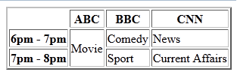
HTML Tables
Example:
<table border="2">
<tr>
<th></th>
<th>ABC</th>
<th>BBC</th>
<th>CNN</th>
</tr>
<tr>
<th>6pm - 7pm</th>
<td rowspan="2">Movie</td>
<td>Comedy</td>
<td>News</td>
</tr>

Slide 35
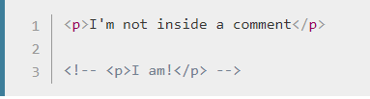
HTML Comment
Ignored by the browser and invisible to the user

Slide 36
HTML Form

Slide 37
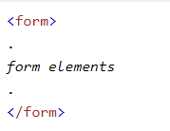
HTML Form
The HTML <form> element defines a form that is used to collect user input:
Attribute :
action : server side file
method : GET or POST
target : _self or _blank

Slide 38
HTML Form : Element
Several types of form controls:
Adding Text
Text Input
Password Input
Text Area
Making Choices
Radio Buttons
Checkboxes
Drop-down boxes
Submitting Forms
Submit buttons
Image buttons
Uploading Files
File upload

Slide 39
HTML Form Submit
If pressed submit to file specified in attribute action
Example:
<input type="submit" name="subscribe" value="Subscribe" />

Slide 40

Text Input
The <input> element is used to create several different form controls. The value of the type attribute determines what kind of input is created.
When <input> has type = “text”, it creates a single- line text input.
<form action="http://www.unpar.ac.id/index.php">
<p>Username:
<input type="text" name="username" size="15" maxlength="30" />
</p>
</form>
Notes:
name = “username” specifies the form control’s name

Slide 41
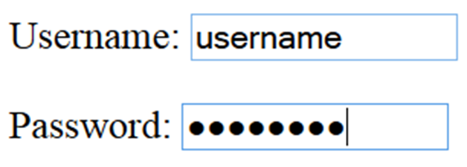
Password Input
When <input> has type = “password” it creates a text box that acts just like a single-line text input, except the characters are blocked out.
<form action="http://www.example.com/login.php">
<p>Username:
<input type="text" name="username" size="15" maxlength="30" />
</p>
<p>Password:
<input type="password" name="password" size="15" maxlength="30"/> </p>
</form>

Slide 42
Text Area
The <textarea> element is used to create a mutli-line text input.
Unlike other input elements this is not an empty element. It should therefore have an opening and a closing tag.
Any text that appears between the opening <textarea> and closing </textarea> tags will appear in the text box when the page loads.

Slide 43
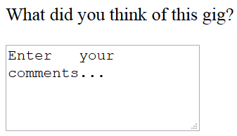
Text Area
<form action="http://www.example.com/comments.php">
<p>What did you think of this gig?</p>
<textarea name="comments" cols="20" rows="4">
Enter your comments...
</textarea>
</form>

Slide 44
Radio Button
When <input> has type=“radio”, it creates a radio button
Radio buttons allow users to pick just one value from a number of predefined options
Options from the same group must have same name attribute
The value attribute indicates the value that will be sent to the server
The checked attribute indicates a default value (thus should be used only on one value per group)

Slide 45


Radio Button
<form action="http://www.example.com/profile.php">
<p>Please select your favorite genre: <br />
<input type="radio" name="genre" value="rock“ checked="checked" /> Rock
<input type="radio" name="genre" value="pop" /> Pop
<input type="radio" name="genre" value="jazz" /> Jazz
</p>
</form>
same name

Slide 46

Check Box
When <input> has type=“checkbox”, it creates a checkbox.
<form action="http://www.example.com/profile.php">
<p>Please select your favorite music service(s): <br>
<input type="checkbox" name="service" value="itunes" checked="checked" /> iTunes
<input type="checkbox" name="service" value="lastfm"/> Last.fm
<input type="checkbox" name="service" value="spotify"/> Spotify
</p>
</form>

Slide 47
Drop Down List Box
The Drop Down List (also known as a select box) allows user to select one option from two or more predefined options
The <select> element is used to create a drop down list box. It contains two or more <option> elements
The <option> element is used to specify the options that the user can select from. The words between the opening <option> and closing </option> tags will be shown to the user in the drop down box
The <option> element uses the value attribute to indicate the value that will be sent to the server
The selected attribute indicates a default value

Slide 48
Drop Down List Box
The function of the drop down list box is similar to that of the radio buttons
There are two key factors in choosing which to use:
If users need to see all options at a glance, radio buttons are better suited.
If there is a very long list of options (such as a list of countries), drop down list boxes work better.

Slide 49
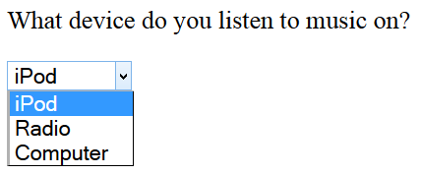
Drop Down List box
<form action="http://www.example.com/profile.php">
<p>What device do you listen to music on?</p>
<select name="devices">
<option value="ipod">iPod</option>
<option value="radio">Radio</option>
<option value="computer">Computer</option>
</select>
</form>

Slide 50
Multiple Select Box
You can turn a drop down select box into a box that shows more than one option by adding the size attribute.
Its value should be the number of options you want to show at once.
You can allow users to select multiple options from this list by adding the multiple attribute with a value of multiple.

Slide 51
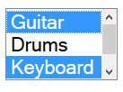
Multiple Select Box
<form action="http://www.example.com/profile.php">
<select name="instruments" size="3" multiple="multiple">
<option value="guitar" selected="selected">Guitar</option>
<option value="drums">Drums</option>
<option value="keyboard" selected="selected">Keyboard</option>
<option value="bass">Bass</option>
</select>
</form>

Slide 52
File Upload Box
When the <input> has type=“file”, it allows user to select a file to be uploaded
When users are allowed to upload files, the method attribute on the <form> element must have a value of POST. (It is not possible to send files using the HTTP GET method.)

Slide 53
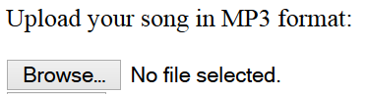
File Upload Box
<form action="http://www.example.com/upload.php" method="post">
<p>Upload your song in MP3 format:</p>
<input type="file" name="user-song" /> <br/>
</form>

Slide 54
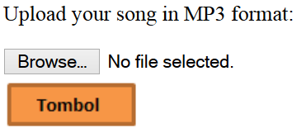
Image Button
To use an image for the submit button, use type=“image”
The src, width, height, and alt attributes work just like they do when used with the <img> element.
<form action="http://www.example.com/upload.php" method="post">
<p>Upload your song in MP3 format:</p>
<input type="file" name="user-song" /><br/>
<input type="image" src="imgbtn.png" value="Upload" />
</form>

Slide 55
Labelling Form Controls
A <label> element makes web form accessible to vision-impaired users
The <label> element can be used in two ways. It can:
Wrap around both the text description and the form input (input text example)
Be kept separate from the form control and use the for attribute to indicate which form control it is a label for (radio button example)

Slide 56

Labelling Form Controls
<label>Age: <input type="text" name="age" /></label> <br/>
Gender:
<input id="female" type="radio" name="gender" value="f">
<label for="female">Female</label>
<input id="male" type="radio" name="gender" value="m">
<label for="male">Male</label>
When a <label> element is used with a checkbox or radio button, users can click on either the form control or the label to select.
The expanded clickable area makes the form easier to use for mouse users
Notes:
<label> benefits: (see http://reference.sitepoint.com/html/label)
It provides a usability improvement for mouse users. In the majority of current web browsers, the text that’s associated with a given form control (by being contained within the <label> and </label> tags) also becomes a clickable area. Thus, if the form control is something small, like a checkbox or radio button, you can massively increase the “hit area” for the mouse user by applying a label to it.
It improves accessibility. By adding a label to all controls, you make the controls’ purpose clear to users of assistive technology (for example, visually impaired users reading the page through a screen reader). If the form controls aren’t linked to their associated text descriptions in this way, the assistive technology may need to hazard a guess as to which control goes with which description, depending on the layout of the web page and/or the source order of the markup to make its interpretation.

Slide 57
Grouping Form Elements
Related form controls can be grouped using <fieldset> element
Most browsers will show the fieldset with a line around the edge to show how they are related.
The appearance of these lines can be adjusted using CSS
The <legend> element can come directly after the opening <fieldset> tag and contains a caption which helps identify the purpose of that group of form controls

Slide 58
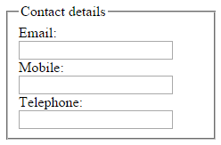
Grouping Form Elements
<fieldset>
<legend>Contact details</legend>
<label>
Email:<br/>
<input type="text" name="email" />
</label><br />
<label>
Mobile:<br/>
<input type="text" name="mobile" />
</label><br/>
<label>
Telephone:<br/>
<input type="text" name="telephone" />
</label>
</fieldset>

Slide 59
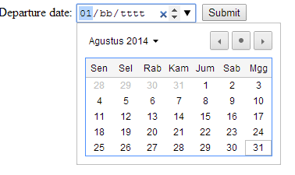
HTML 5: Date Input
HTML5 introduces new form controls to standardize the way that some information is gathered.
<input type=“date”> creates a date picker box
<form action="http://www.example.com/bookings/" method="post">
<label for="username">Departure date:</label>
<input type="date" name="depart" />
<input type="submit" value="Submit"/>
</form>

Slide 60
Thanks

Slide 61
Read More
https://www.w3schools.com/html
Basic
Elements
Attributes
Headings
Paragraphs
Formatting
Links (+Exercise)
Images (+Exercise)
Tables (+Exercise)
Lists (+Exercise)
HTML Forms (+Exercise)

